Slide 1

BASIC THESIS
Topic: Building a simple note taking app
Student: Nguyễn Quang Vinh
Student ID: B2105727
motphutcantho.com

Slide 2
LIST OF FUNCTIONS
Navigation Drawer
Note
Checklist
Reminder and notification
Progress Tracker
motphutcantho.com

Slide 3
APPLIED TECHNOLOGY
Android Studio
Kotlin
SQLite
motphutcantho.com

Slide 4
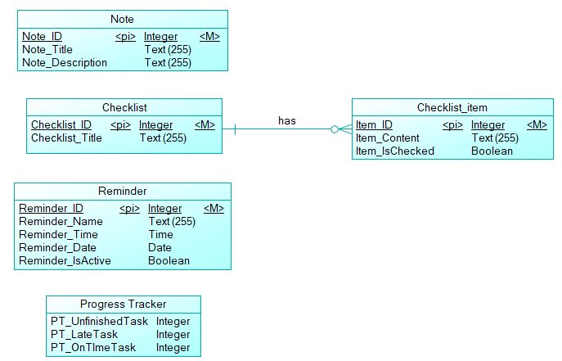
DATABASE DESIGN
motphutcantho.com

Slide 5
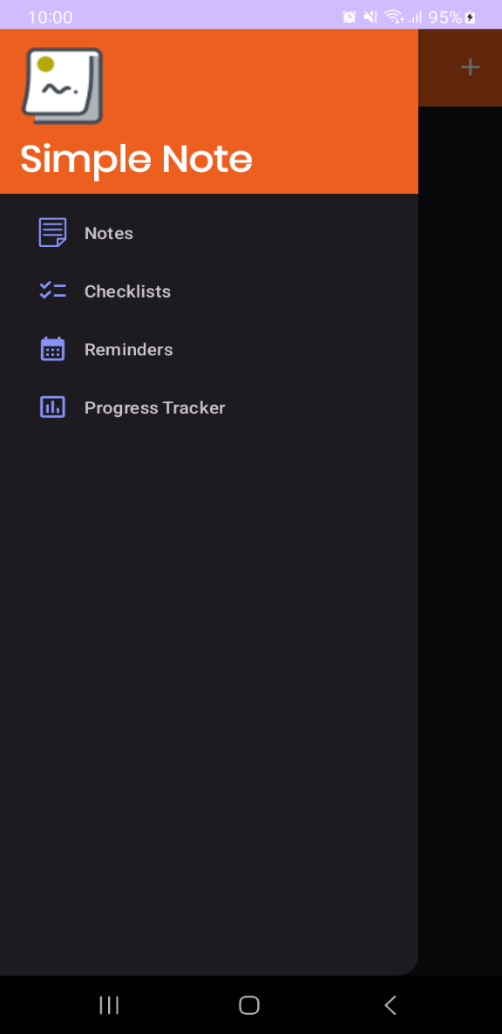
NAVIGATION DRAWER
motphutcantho.com

Slide 6
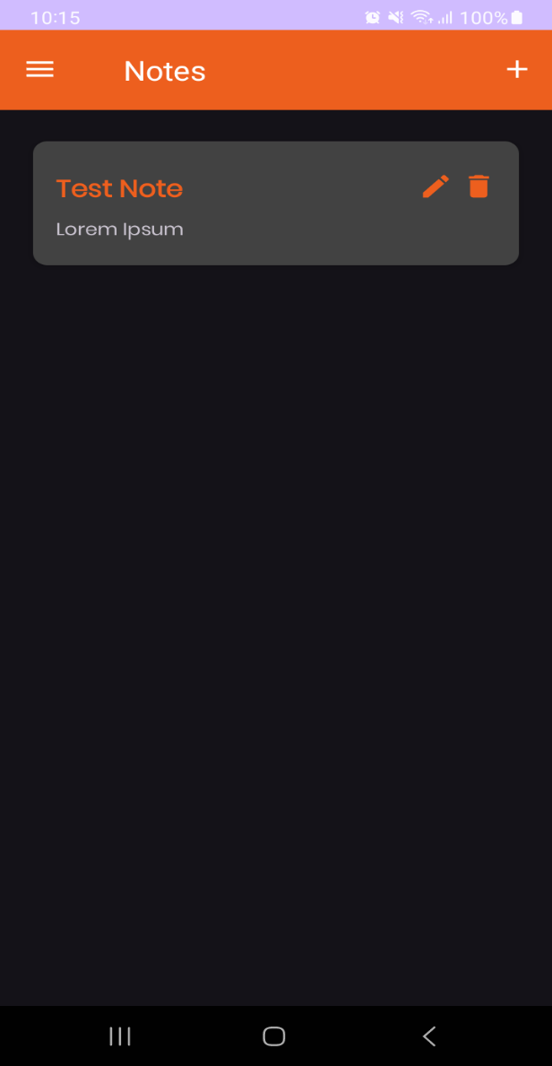
NOTE MENU
motphutcantho.com

Slide 7
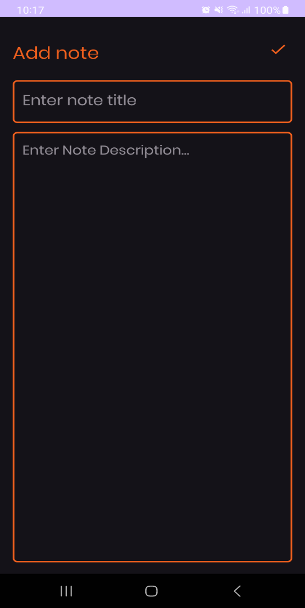
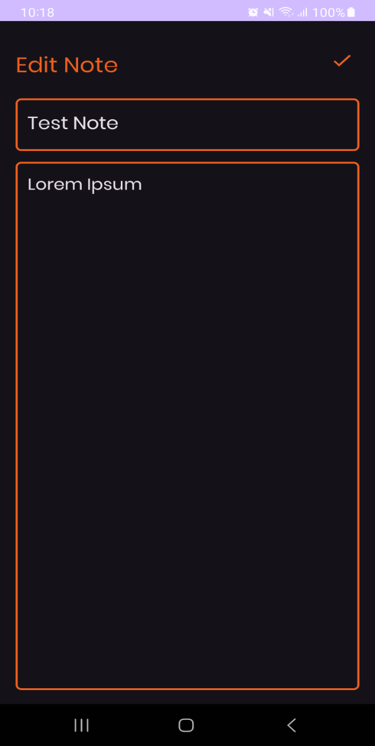
ADD NOTE AND EDIT NOTE
motphutcantho.com

Slide 8
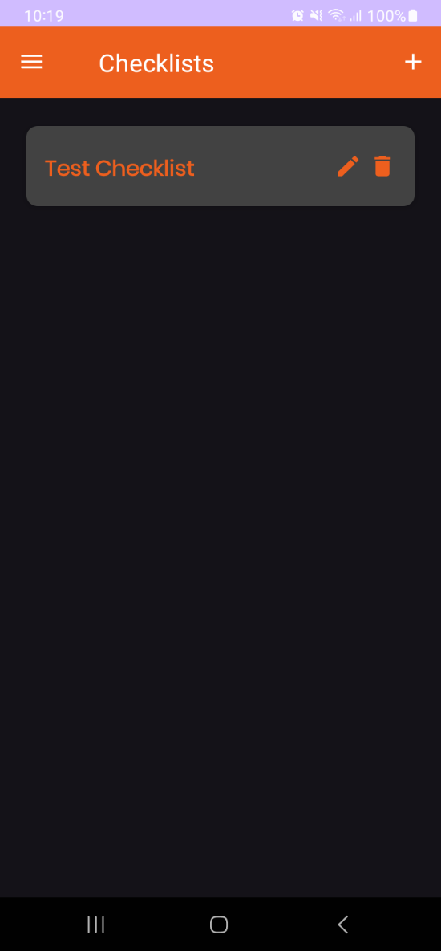
CHECKLIST MENU
motphutcantho.com

Slide 9
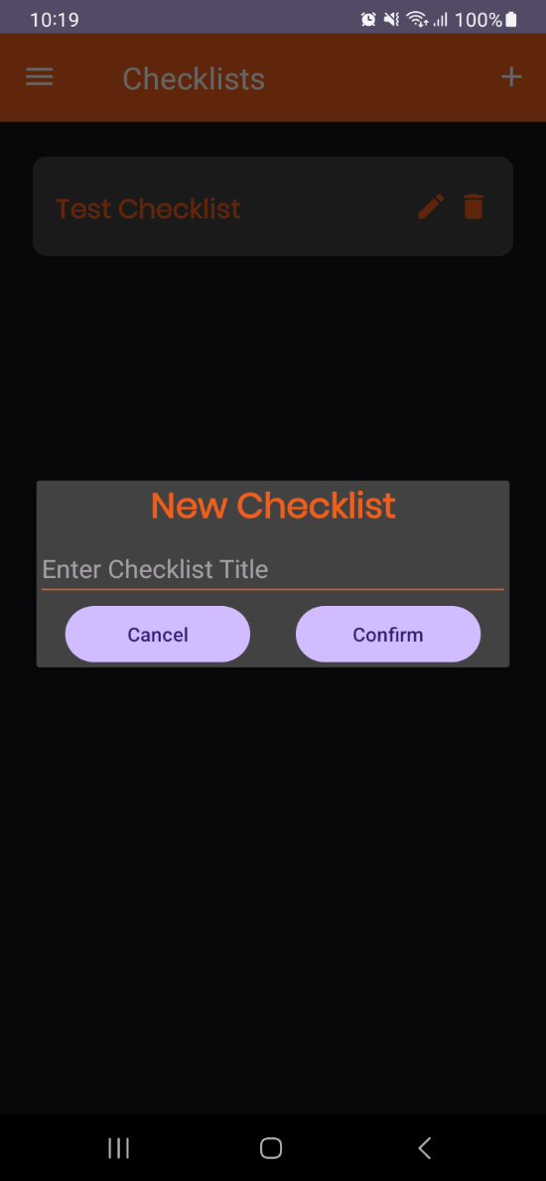
ADD CHECKLIST DIALOG
motphutcantho.com

Slide 10
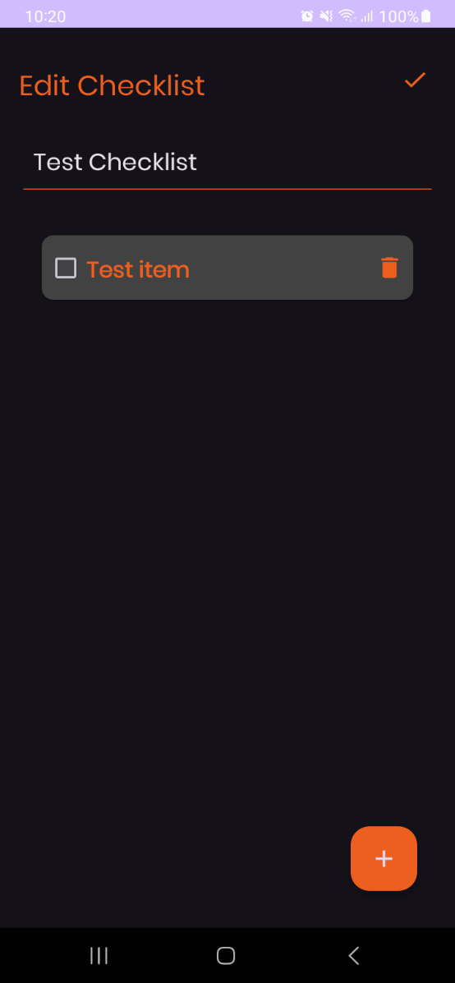
EDIT CHECKLIST
motphutcantho.com

Slide 11
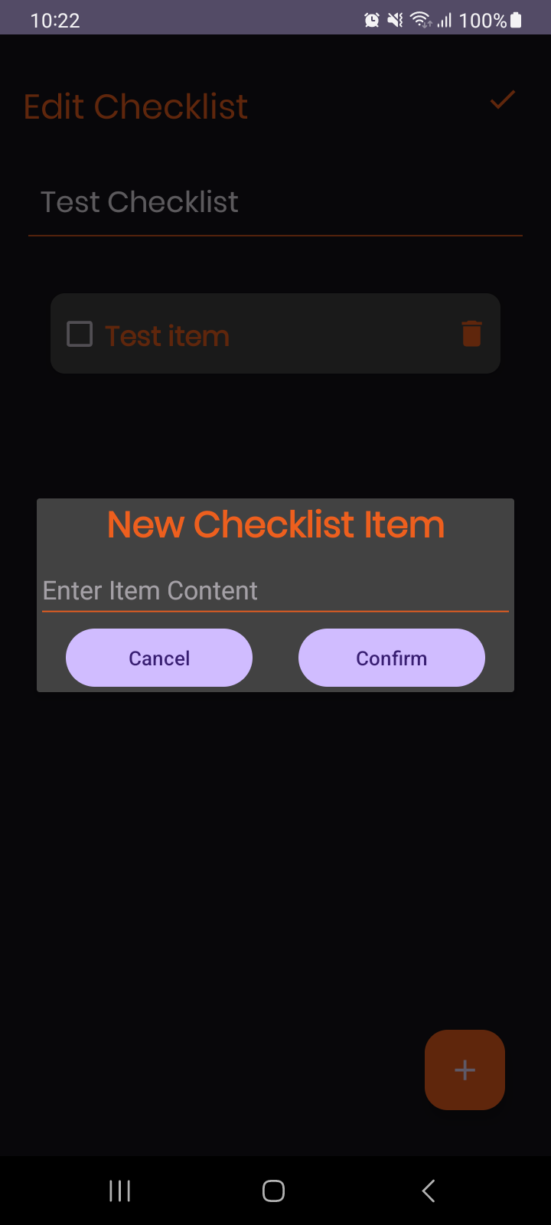
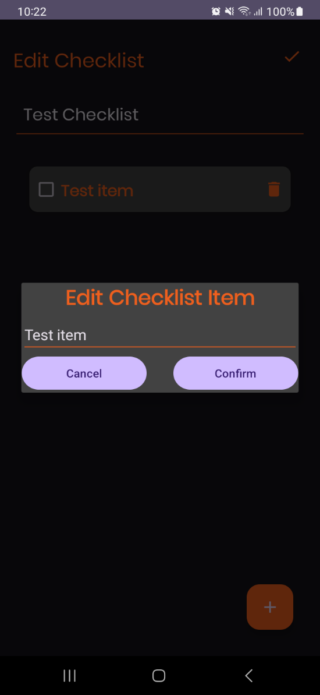
ADD AND EDIT ITEM DIALOG
motphutcantho.com

Slide 12
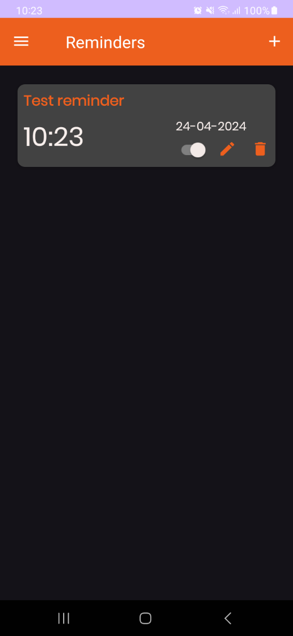
REMINDER MENU
motphutcantho.com

Slide 13
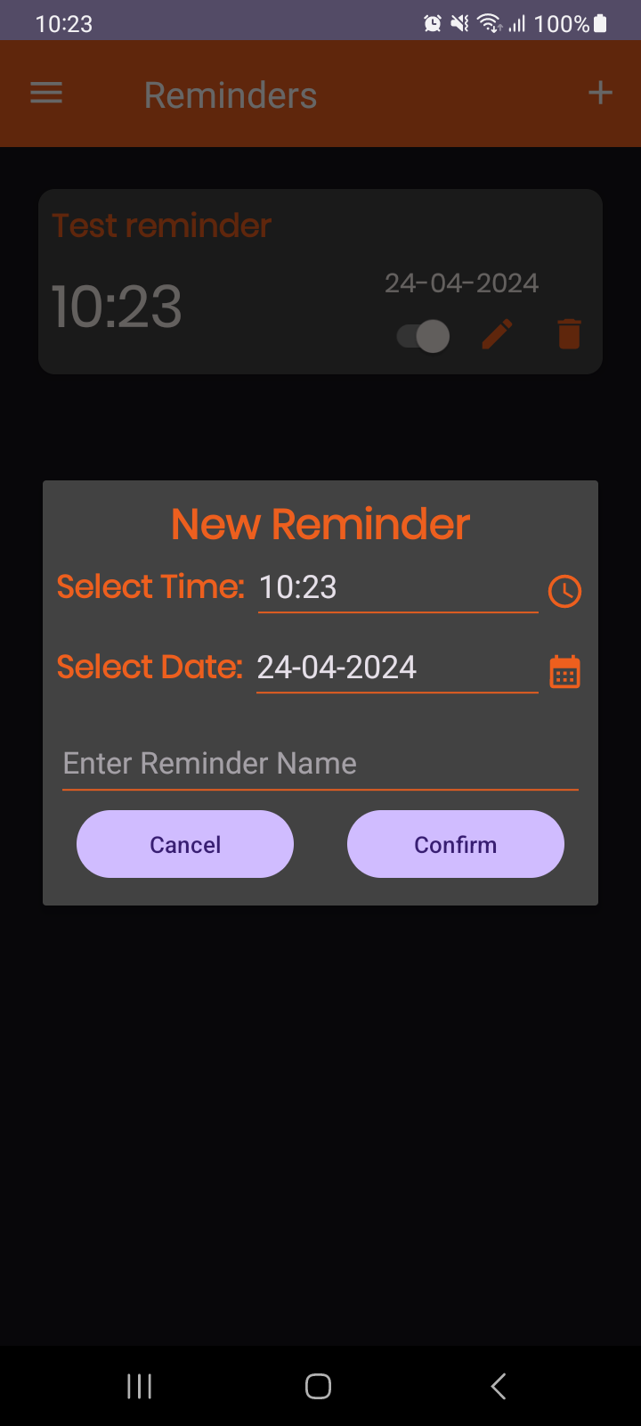
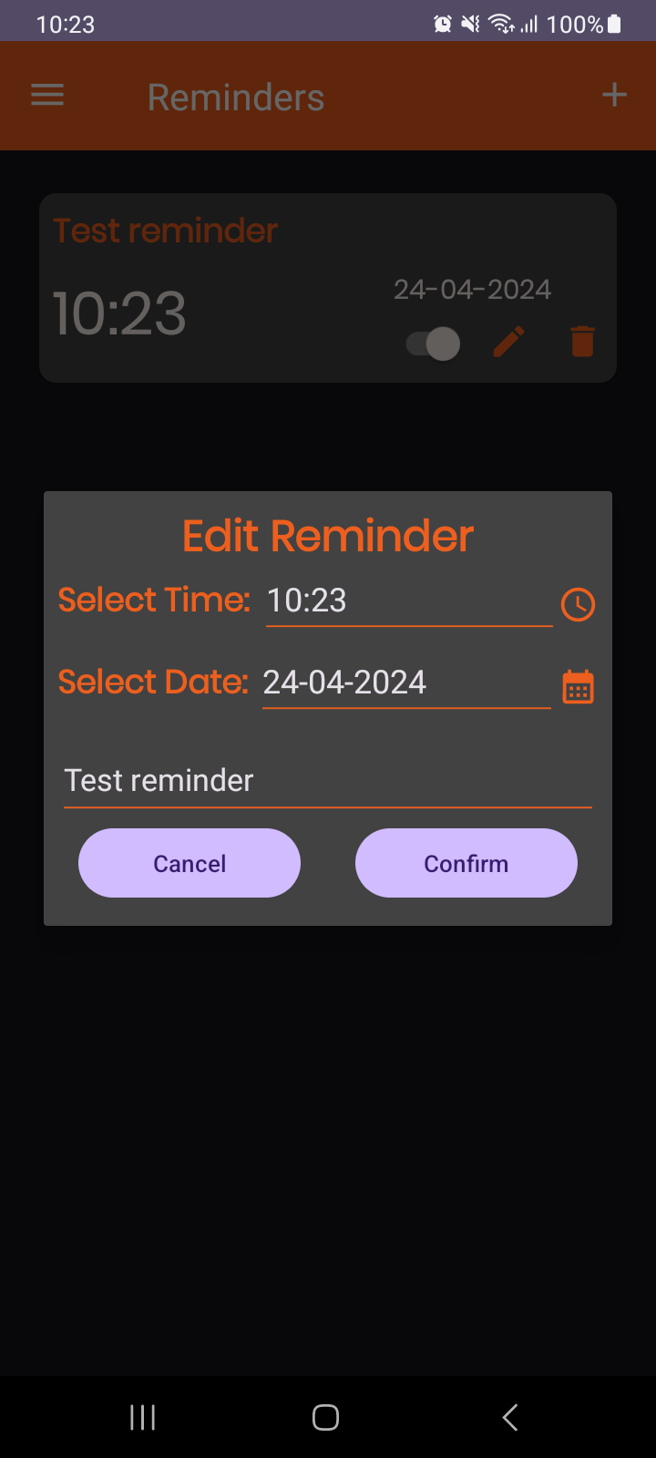
ADD AND EDIT REMINDER DIALOG
motphutcantho.com

Slide 14
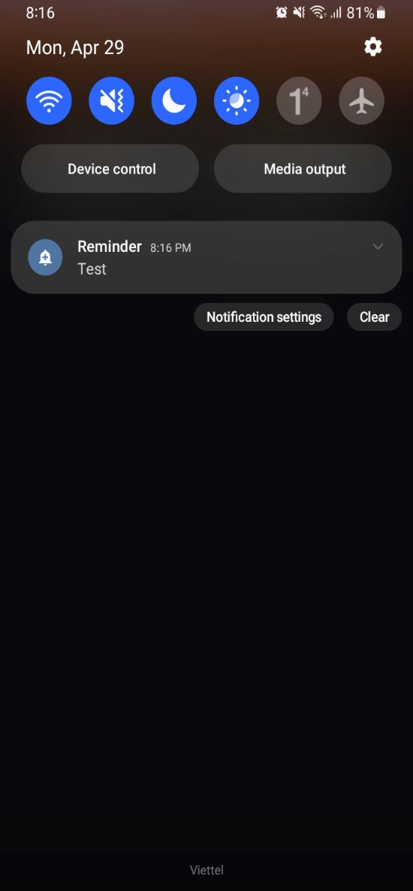
NOTIFICATION
motphutcantho.com

Slide 15
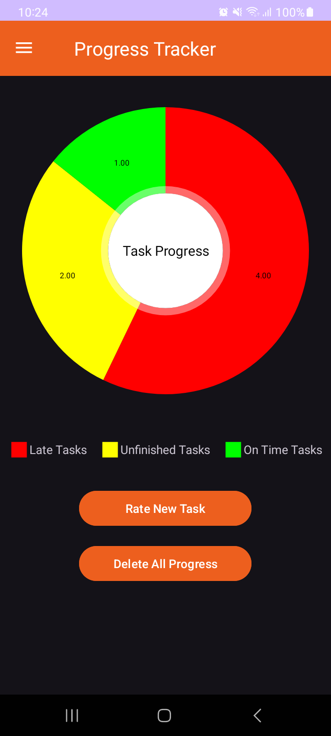
PROGRESS TRACKER MENU
motphutcantho.com

Slide 16
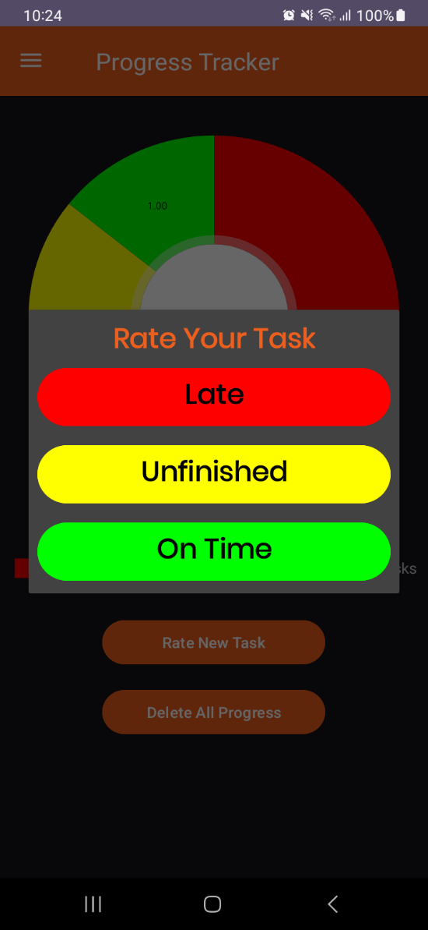
RATE TASK DIALOG
motphutcantho.com

Slide 17
Thanks for listening
motphutcantho.com

